Slide 1
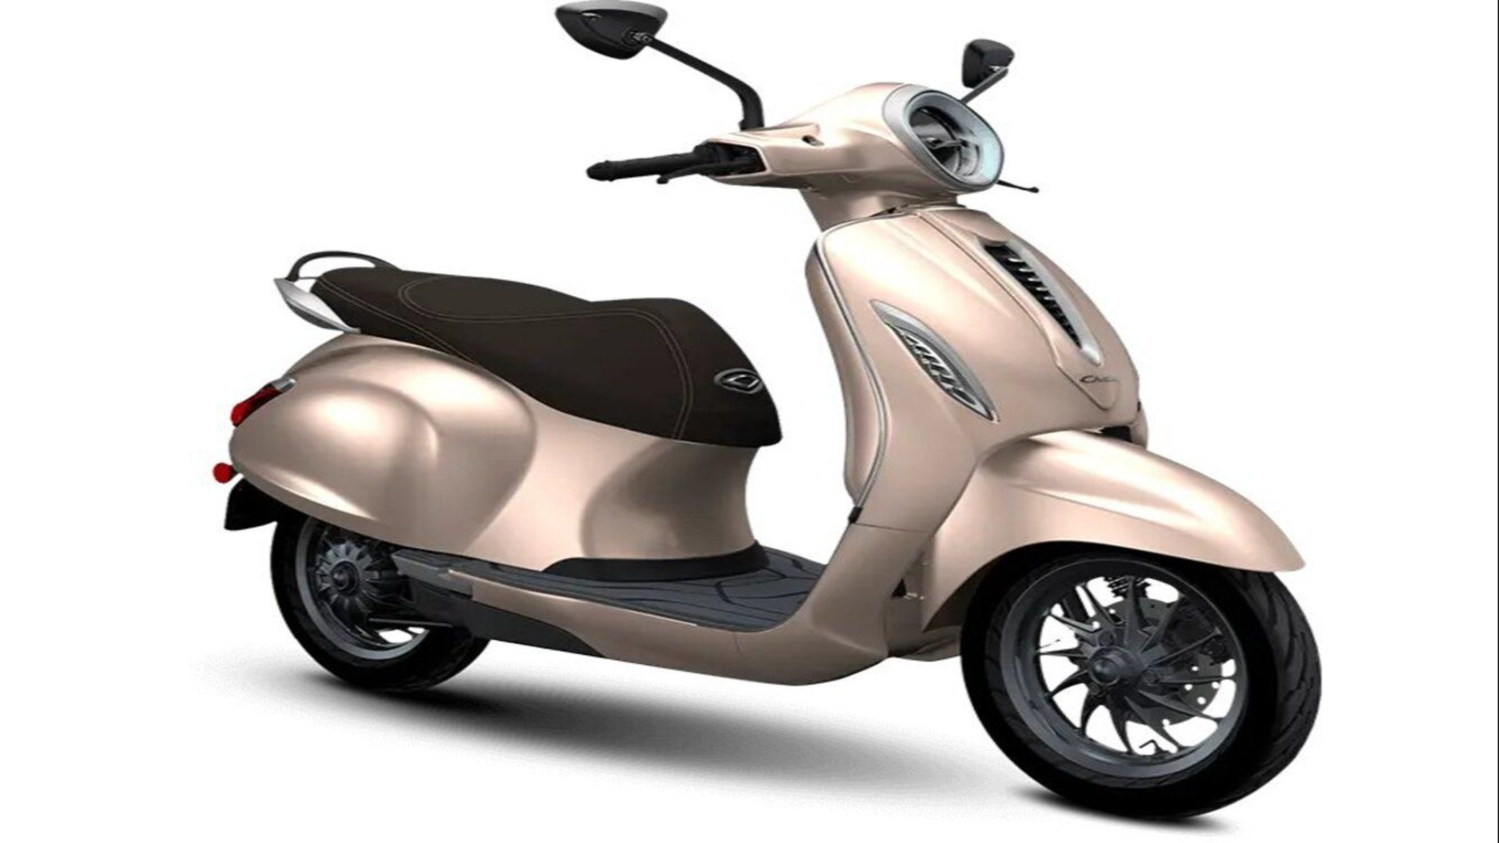
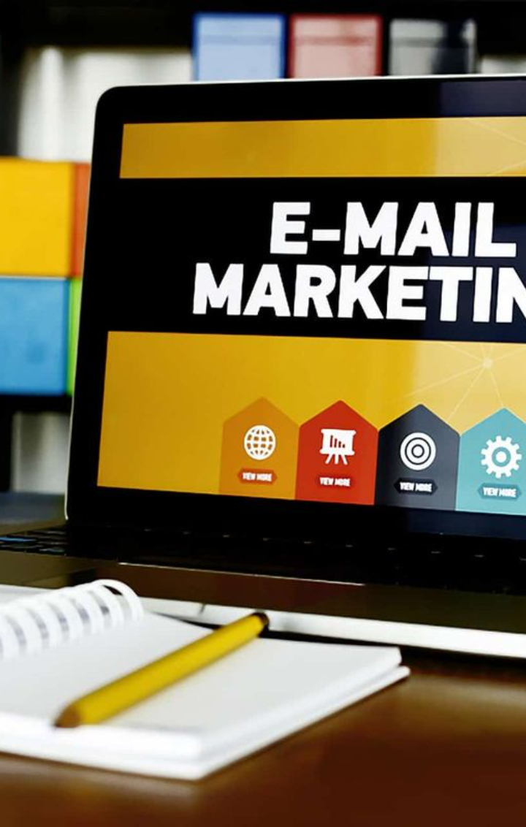


Assessing the Effectiveness of Email Campaigns
Explore the impact of email campaigns on customers' purchasing decisions by analyzing email opening rates, click-through rates, and industry benchmarks.

Slide 2
Revving Up Our Email Campaign
Measuring Effectiveness
Our presentation aims to chart the impact of our electrifying email campaign, particularly the debut of our Sprint scooters, on customer behavior. Did our emails catch their eye and urge them to click through?
By scrutinizing these key performance indicators, we can measure the overall effectiveness and quality of our email campaign. This analysis is essential in gauging not only the reach and engagement of our campaign but also its ability to ignite potential customers' purchasing decisions.

Slide 3
E-mail Summary for Sprint Campaign
E-mails Sent
35,067
Opened
6,995
Clicked
848
Bounced
125
Unsubscribed
92
These numbers provide a detailed snapshot of our email campaign's reach and engagement. The majority of recipients opened our emails, showcasing a strong initial interest. However, there is room for improvement in increasing the Click Rate. Additionally, the number of unsubscribes is something to keep an eye on, and we may need to adjust our messaging or frequency to better align with our subscribers' preferences.

Slide 4

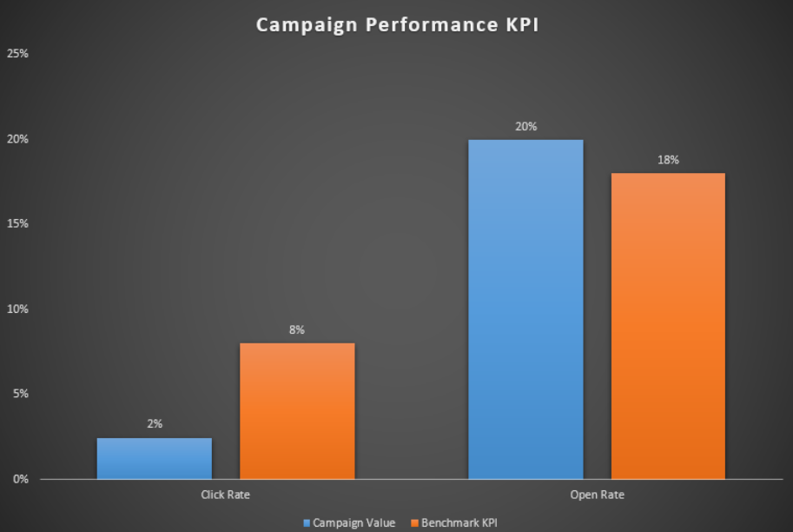
Email Campaign Effectiveness
Campaign Value
Benchmark KPI
Click Rate
2%
8%
Open Rate
20%
18%
Let's delve into the performance of our recent email campaign for Sprint scooters based on the provided key performance indicators (KPIs) and benchmark values.
Click Rate:
The Click Rate, representing the proportion of recipients who clicked on the provided links, is a critical metric indicating active engagement. Our campaign achieved a Click Rate of 2%, which falls below the industry benchmark of 8%. While we did garner clicks, there is an opportunity to enhance engagement and drive more interactions.
Open Rate:
The Open Rate, reflecting the percentage of recipients who opened our Sprint scooter-related emails, is a key indicator of initial engagement. Our campaign excelled with an Open Rate of 20%, surpassing the industry benchmark of 18%. This suggests that our emails were effective in capturing the attention of our audience.

Slide 5
Engagement Booster
1
Enhancing Engagement
Unleash the power of creativity to captivate your audience and inspire them to click. Optimize email content, craft compelling calls-to-action, and sprinkle interactive incentives to keep them hooked.
2
Bounce Eliminator
Embark on a thrilling investigation to uncover the reasons behind email bounces. Eliminate barriers and ensure that future campaigns reach a wider audience, boosting your impact and expanding your reach.
3
Benchmark Ninja
While our Open Rate has soared above the benchmark, let's turn our attention to the Click Rate. Align it even closer to industry standards, ensuring that our campaign leaves a lasting impression and generates the desired actions.
4
Optimization Maestro
Harness the power of insights gained from this analysis. Fine-tune and optimize future email campaigns in an iterative process, unlocking continuous improvement, and achieving peak performance.

Slide 6

Conclusion
Summary of Findings
Implications and Recommendations
Consolidate the key findings from the evaluation of the email campaign, highlighting its strengths and weaknesses.
Discuss the implications of the findings and provide actionable recommendations to enhance the effectiveness of future email campaigns.

